Slide 1
SPELLMAN HIGH VOLTAGE
INTEGRATED KV IMAGING SOLUTIONS
Powering a Better Future for Medical Imaging

Slide 2
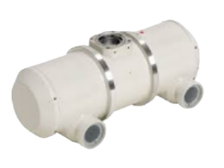
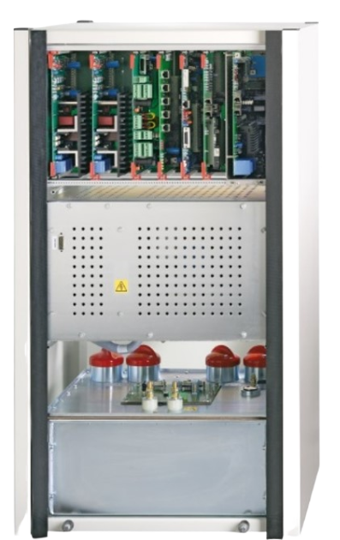
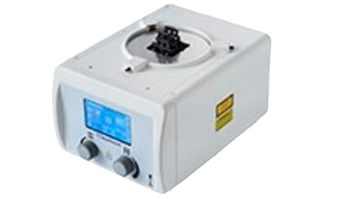
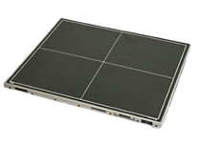
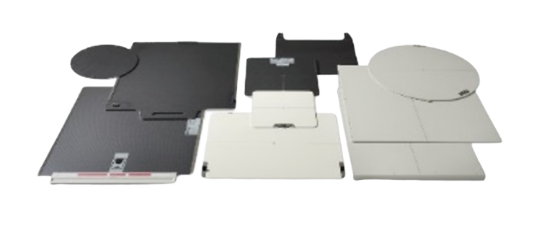
INTEGRATED KV IMAGING SOLUTIONS
Partnering with industry leading component suppliers to offer best in breed kV imaging solutions to our customers.
BENEFITS:
kV imaging components in stock.
Simplified supply chain.
Single source of support.
Pre-engineered solution: high performance out of the box.
70 plus years of experience and insight.
One Shipment.
One Call for Support.

Slide 3
INTEGRATED KV IMAGING SOLUTIONS
WITH “POWERED BY SPELLMAN” INTEGRATED KV IMAGING SOLUTIONS, YOU CAN AVOID COMMON CHALLENGES SUCH AS:
Integrating a new component
Troubleshooting
Assuring Compatibility as devices get iterated.
Coordinating Shipments from Multiple Sources.

Slide 4
SIMPLICITY THE SPELLMAN WAY
Industry leading performance… Made Simple.

