Slide 1
SPELLMAN HIGH VOLTAGE
MAMMOGRAPHY
Powering a Better Future for Medical Imaging

Slide 2
MAMMOGRAPHY X-RAY GENERATORS
VMX & PMX MAMMOGRAPHY GENERATORS
VMX and PMX are Spellman’s Products for The Mammography Market For Cathode Grounded Single Ended X-Ray Tubes.
FEATURING:
Common communication and interface. (RS232 & Discrete Signals)
Compact Design. (VMX is 12.5 L and PMX is 13.4 L in Volume)
Dual Speed Starter.
VMX is optimized for Breast Screening Applications.
PMX is Optimized for Tomosynthesis and 3D Imaging Applications.

Slide 3
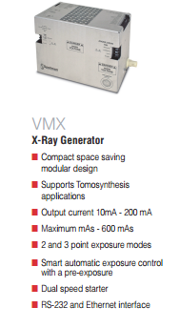
MAMMOGRAPHY X-RAY GENERATORS
VMX FEATURES:
5 kW Maximum Output Power
20 to 40 kV max. kVp
180 to 264 VAC Single Phase Input.
10 to 200 mA Output Current Range.
5 to 10000 ms Timer Range.
TYPICAL APPLICATIONS:
Screening Mammography
Biopsy

Slide 4
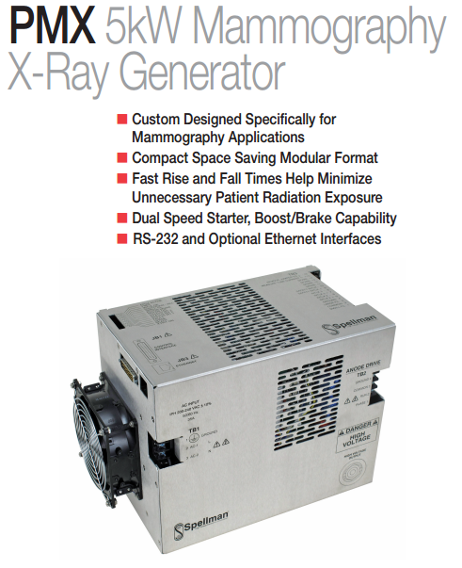
MAMMOGRAPHY X-RAY GENERATORS
PMX FEATURES:
5 kW Maximum Output Power
20 to 49 kV max. kVp
180 to 264 VAC Single Phase Input.
10 to 200 mA Output Current Range.
5 to 10000 ms Timer Range.
TYPICAL APPLICATIONS:
Novel Screening Systems
CBCT

