Slide 1
SPELLMAN HIGH VOLTAGE
MAMMOGRAPHY: PMX70
Powering a Better Future for Medical Imaging

Slide 2
MAMMOGRAPHY X-RAY GENERATORS
PMX70 MAMMOGRAPHY & 3D IMAGING GENERATORS
VMX and PMX are Spellman’s Products for The Mammography Market For Anode Grounded Single Ended X-Ray Tubes.
FEATURING:
Common communication and interface. (RS232 & Discrete Signals)
Compact Design. (35.4L)
Dual Speed Starter.
PMX70 is Optimized for 3D Imaging Applications.

Slide 3
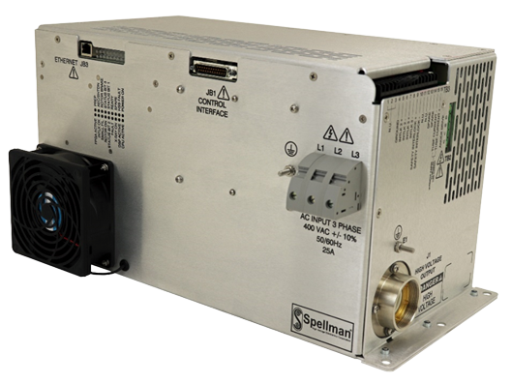
MAMMOGRAPHY X-RAY GENERATORS
PMX70 FEATURES:
12 kW Maximum Output Power
20 to 70 kV max. kVp
180 to 264 VAC Single Phase Input.
360 to 440 VAC Three Phase Input.
10 to 200 mA Output Current Range.
TYPICAL APPLICATIONS:
Novel Screening Systems
CBCT
1 to 60 pulses per second frequency range.

