Slide 1
SPELLMAN HIGH VOLTAGE
MEDICAL MONOBLOCKS
Powering a Better Future for Medical Imaging

Slide 2
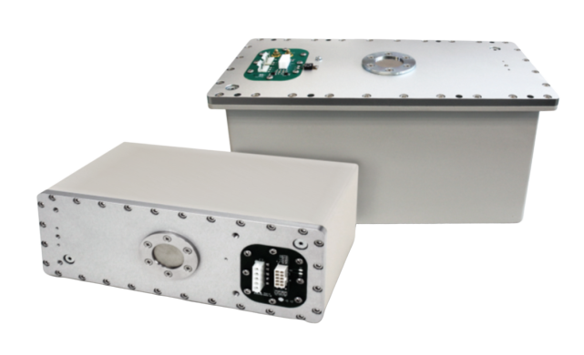
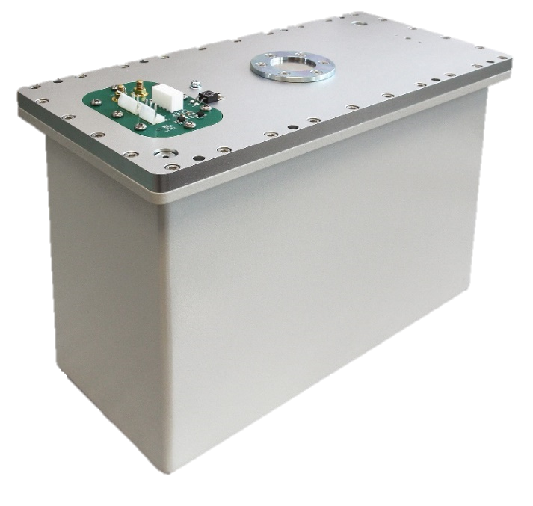
X-RAY MEDICAL MONOBLOCKS® MMB
Spellman offers a family of Medical Monoblock Products for customers seeking high performance fluoro imaging.
36,400 Monoblocks built since 2000
Greater than 5000 units shipped per year

Slide 3
3.5 KW MMB
3.5 KW MONOBLOCKS®
3.5 KW MMB FEATURES:
3.5 kW Maximum Output Power
40 to 125 kV max. kVp
190 to 264 VAC Single Phase Input.
0.5/1.6 Focal Spot tube available
0.2 to 40 mA Output Current Range.
TYPICAL APPLICATIONS:
Orthopedic
Image Guided Surgery
SPECT/CT
IGRT.
Pulsed Fluoro.

Slide 4
20 KW MMB
20 KW MONOBLOCKS®
20 KW MMB FEATURES:
20 kW Maximum Output Power
40 to 125 kV max. kVp
190 to 264 VAC Single Phase Input.
0.3/0.6 Focal Spot tube available
0.2 to 350 mA Output Current Range.
TYPICAL APPLICATIONS:
Vascular Imaging
Image Guided Surgery.
IGRT.
Pulsed Fluoro.

